Slide 1

Importance of UI/UX Design in Software Development
Symbiosis Institute of Technology
Aqsa Kazi
Design Head, GDSC SIT

Slide 2
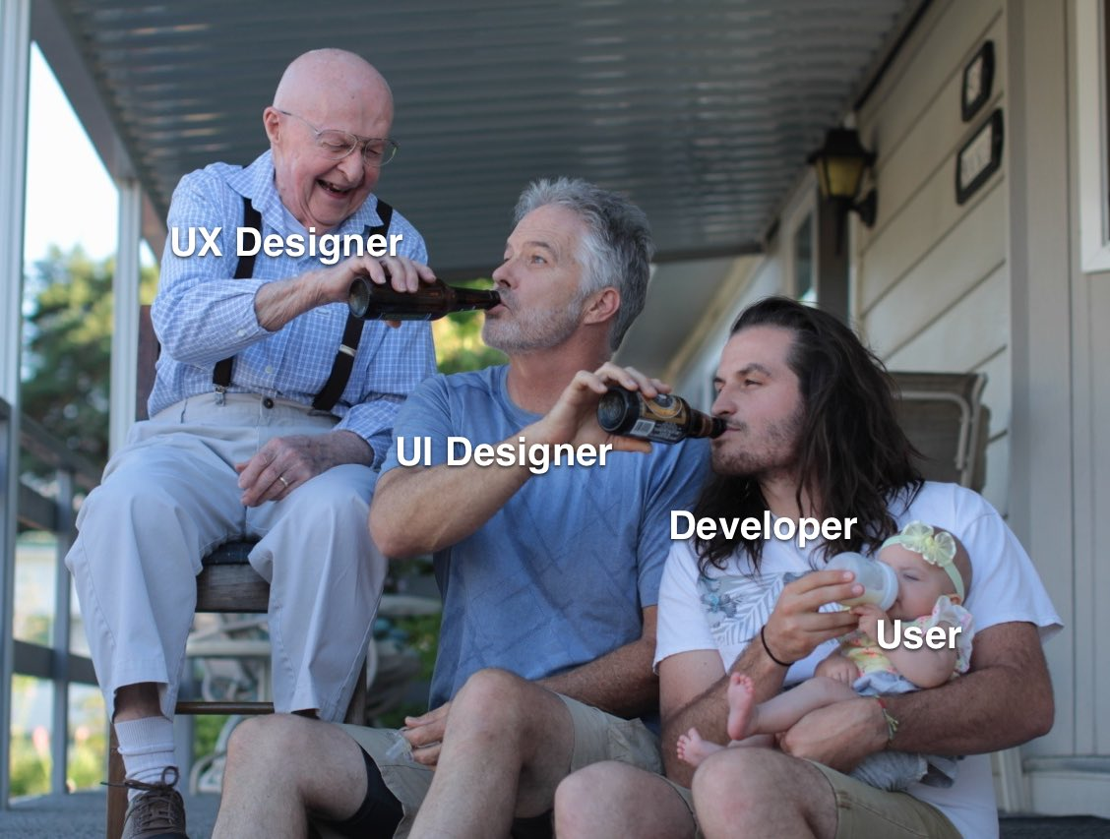

Slide 3

Agenda
Design Thinking Process.
What is UI and UX?
Four Golden Rules of UI.
UX Honeycomb.
Aspects of UI/UX.
Branding.
Usability.
User Satisfaction.
Scope of UI/UX in Software Development.

Slide 4
Good Design is also an act of communication between the designer and the user, except that all the communication has to come about by the appearance of the device itself.
The device must explain itself.
Donald Norman.

Slide 5
Design Thinking Process
Design thinking is a non-linear, iterative process that design teams use to understand users, challenge assumptions, redefine problems and create innovative solutions to prototype and test.
Empathize.
Research your user’s needs.
Ideate.
Challenge assumptions and create ideas.
Test.
Try your solutions out.
1
2
3
4
5
Define.
State your user’s needs and problems.
Prototype.
Start to create solutions.

Slide 6
What is UI?
User Interface (UI) design is the process designers use to build interfaces in software or computerized devices, focussing on looks or style.
It determines how commands are given to the computer or the program and how information is displayed on the screen.
A poorly designed interface can cause a user to make catastrophic errors.
Three main types of user interfaces are:
Command Language.
Menus.
Graphical User Interface.

Slide 7
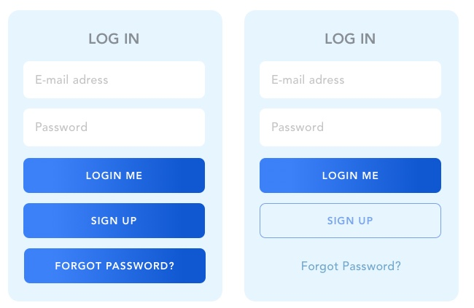
Which UI is better?
boom
yoo

Slide 8
Four Golden Rules of UI Design
Place users in control of the interface.
Make it comfortable to interact with a product.
Reduce cognitive load.
Make user interfaces consistent.

Slide 9
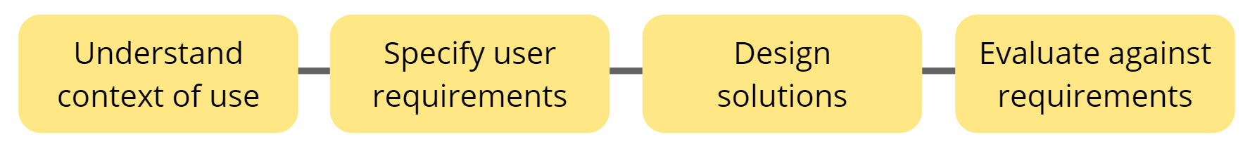
What is UX?
User Experience (UX) design is the process design teams use to create products that provide meaningful and relevant experiences to users.
UX designers consider the Why, What and How of product use.
UX Design is user centred.

Slide 10
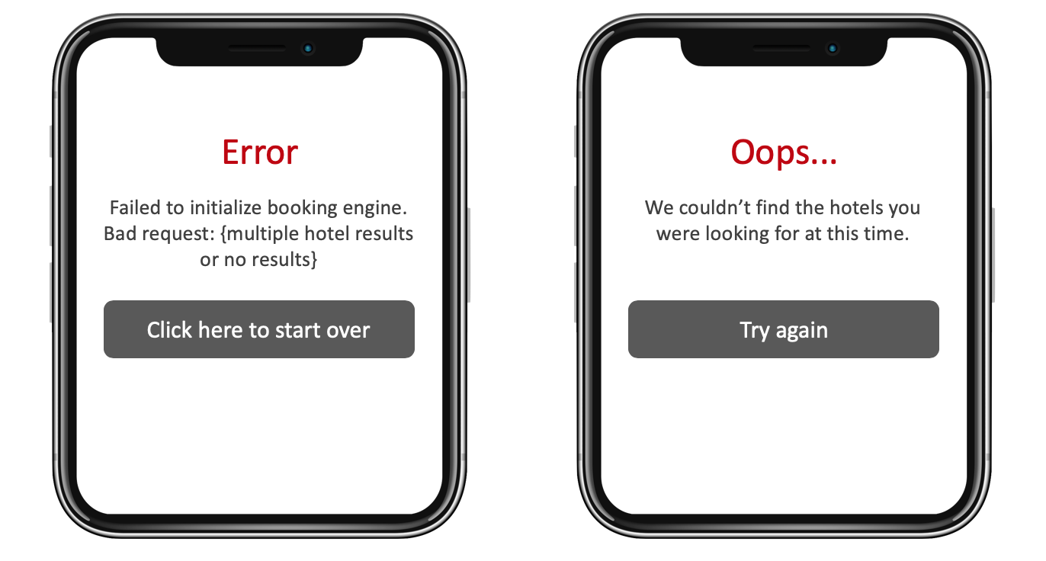
Which UX is better?
yayy
hurray

Slide 11
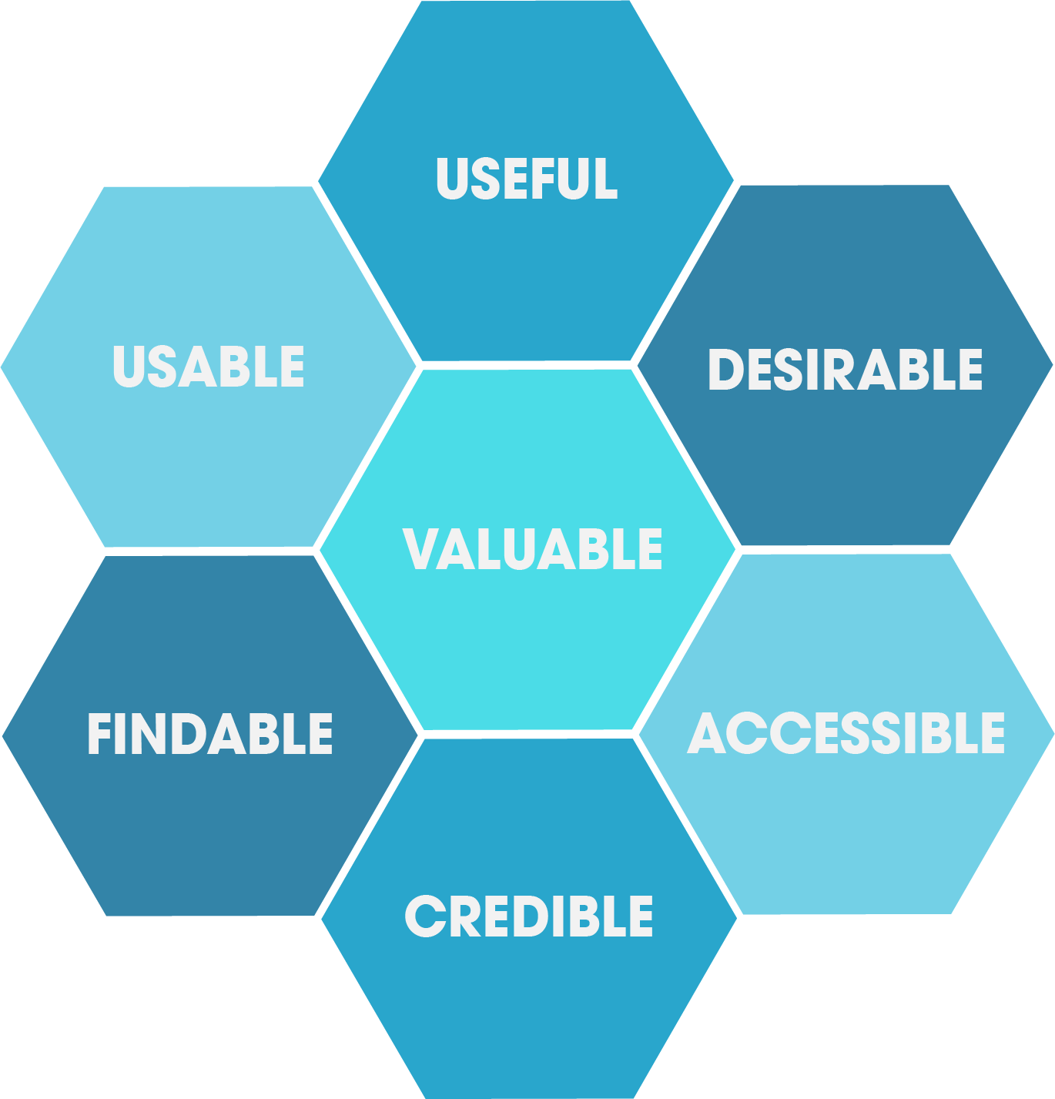
UX Honeycomb

Slide 12
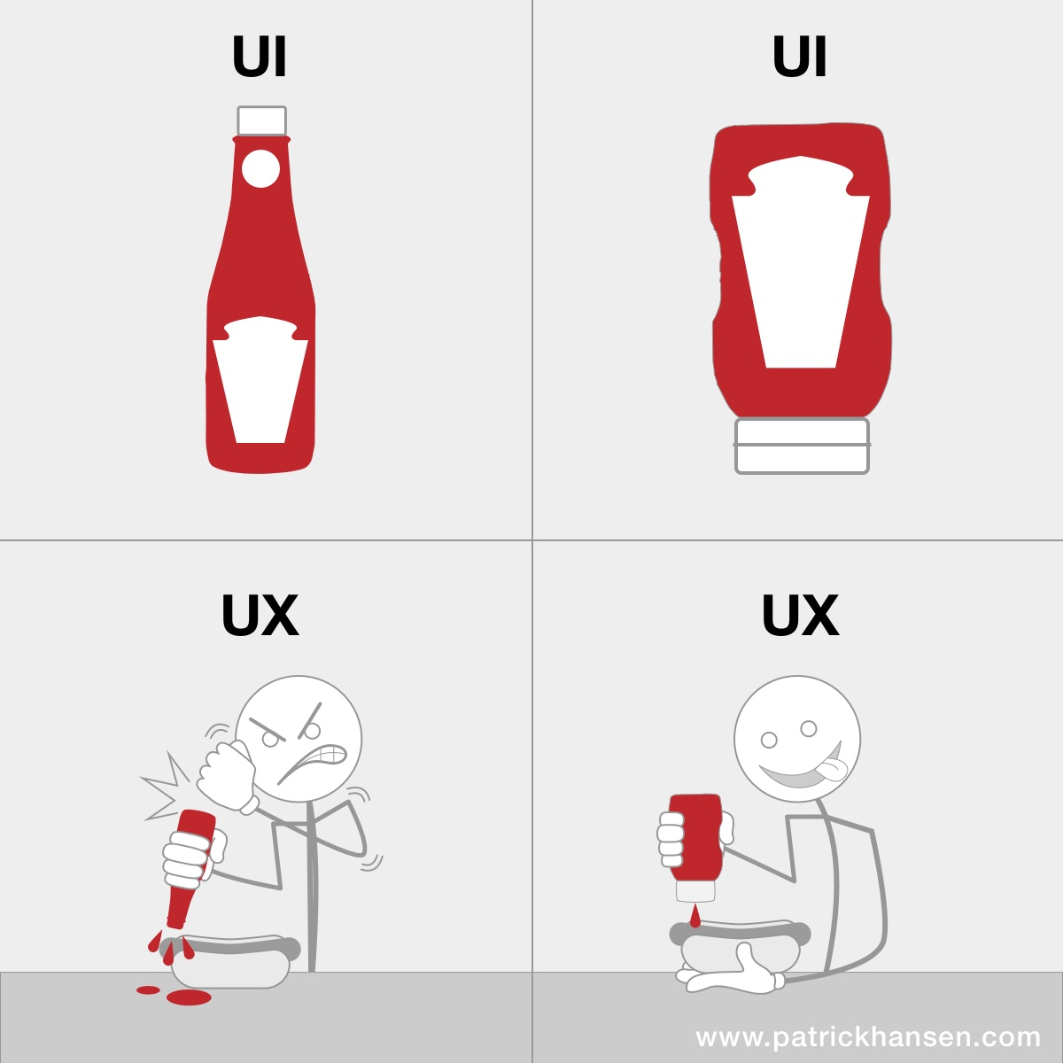

Slide 13
Aspects of UI/UX

Slide 14
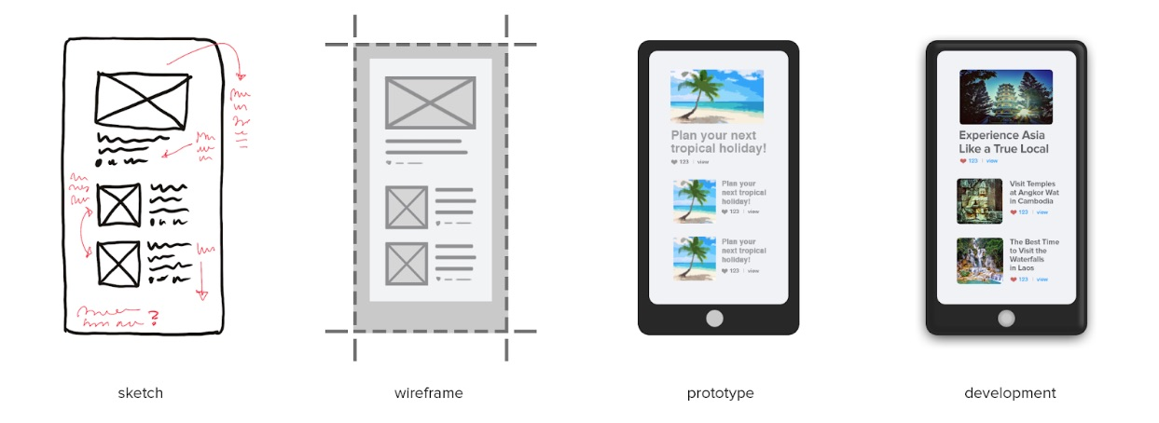
Wireframing & Prototyping

Slide 15
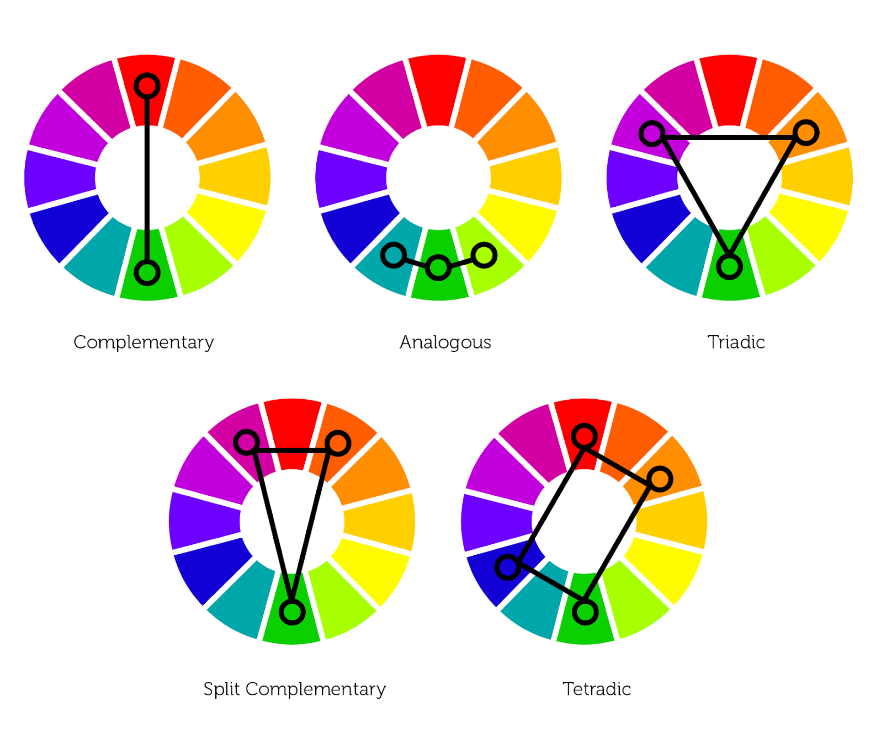
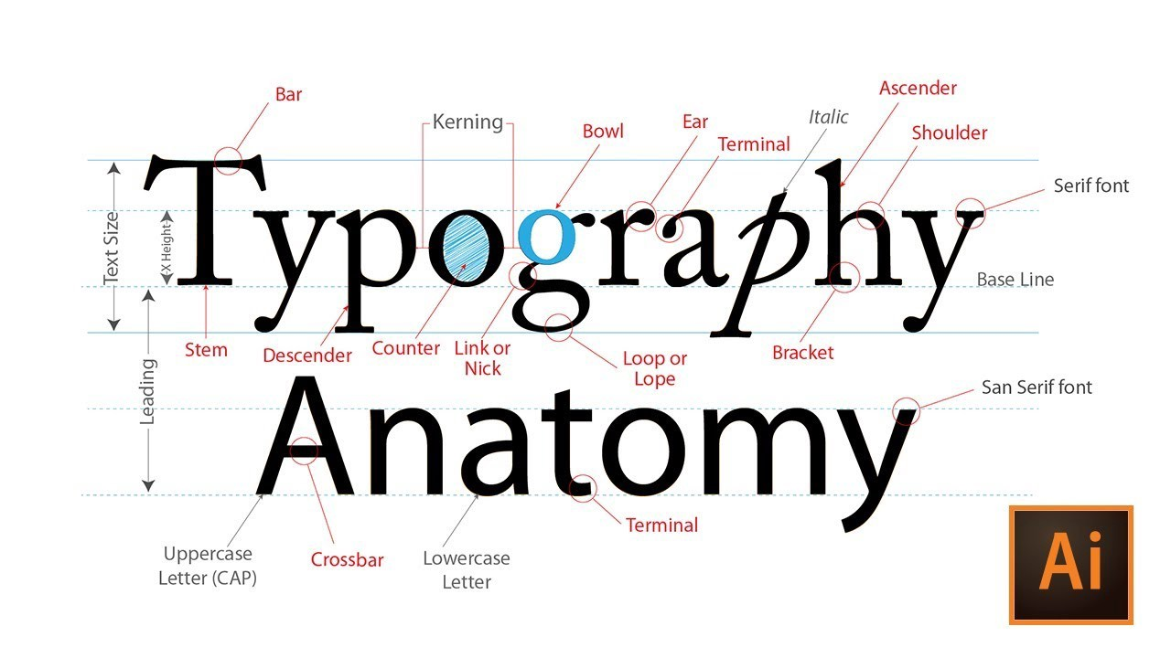

Colour Theory & Typography

Slide 16

Visuals, Formats & Features
Efficiency
Adaptive
Aesthetics
Uniformity
Minimalism
Interactive
Consistency

Slide 17
Brand establishment
Branding in general is the set of marketing and psychological techniques and steps aiming at promotion of a product, service, persona etc. first of all via setting a brand.
General Branding elements are:
Logo.
Brand colours.
Typography.
Graphic elements.
Templates.

Slide 18

Usability &
User Satisfaction
Users LOVE applications which are user-friendly.
Time spent on the UX and UI interface is designed to attract and retain users for your application.
Customer satisfaction leads to them being loyal to our brand and thus increases the ROI for it.

Slide 19
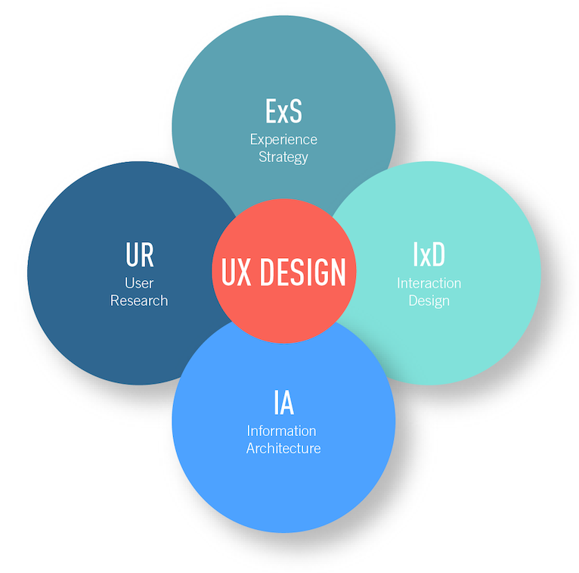

Scope of UI/UX Designers in Software Development

Slide 20



Any questions?
dsc.sit@gmail.com
dsc_sit

Slide 21
Thank You!
aqsa.kazi.btech2020@sitpune.edu.in

